Slide 1
Digital Portfolio
STUDENT NAME: Srishti Kumari Parichha
REGISTER NO AND NMID: asunm189222403117
DEPARTMENT: B.Sc. Computer Science
COLLEGE: CSI Ewart Women’s Christian College

Slide 2
PROJECT TITLE :
Digital Portofolio website

Slide 3


AGENDA
Problem Statement
Project Overview
End Users
Tools and Technologies
Fitness Calculator design and Layout
Features and Functionality
Results and Screenshots
Conclusion
Github Link
3/21/2024 Annual Review

Slide 4

PROBLEM STATEMENT
In today’s digital era, presenting personal achievements, creative works, and professional details in an organized and visually appealing way is important for both academic and career growth. Traditional resumes and text-based documents fail to highlight creativity and individuality. There is a need for a simple, accessible, and professional platform where individuals can showcase their personal background, achievements, projects, and contact information in an attractive format.
The Portfolio website addresses this by providing an online portfolio that combines personal details, images, and achievements into a single responsive web application. This helps users create a strong online presence, improves visibility, and allows easy sharing of their work with peers, recruiters, or institutions.

Slide 5

PROJECT OVERVIEW
The Portfolio Project is a personal portfolio website developed using HTML, CSS, and JavaScript to showcase an individual’s profile in a creative and professional manner. The project allows a user to present their name, signature image, short introduction, background, email, contact details, and achievements in a well-structured and visually appealing format.
The main aim of this project is to provide a digital identity for individuals such as students, professionals, or artists, where they can highlight their skills, creativity, and accomplishments beyond traditional resumes. Unlike paper-based resumes or static documents, the Photofolio website is interactive, responsive, and easily accessible online.
This project is deployed using GitHub Pages, ensuring that the portfolio is available publicly on the internet and can be shared easily with recruiters, peers, or institutions. By combining web technologies and design principles, Photofolio provides an efficient solution for creating a personal brand presence in the digital world.

Slide 6

WHO ARE THE END USERS?
Students –
To showcase their academic achievements, projects, and skills online.
Useful for placements, internships, or higher studies applications.
Job Seekers / Professionals –
To present a creative online resume with personal details, background, and accomplishments.
Makes it easier for recruiters to access portfolios through a simple link.
Photographers / Designers / Artists –
To display creative work, images, or designs in a professional portfolio format.
Teachers / Institutions –
To evaluate student work or project submissions in a digital and organized way.
General Public / Recruiters –
Anyone interested in viewing the portfolio to know more about the person (background, achievements, and skills).

Slide 7
TOOLS AND TECHNIQUES
1. Tools Used
HTML5 → for structuring the content of the web pages (name, introduction, background, achievements, contact).
CSS3 → for styling, layout, colors, fonts, and responsive design.
JavaScript (ES6) → for interactivity (form validation, dynamic elements, animations, etc.).
Git & GitHub → for version control, code management, and hosting the Photofolio using GitHub Pages.
Code Editor (VS Code) → for writing and debugging the project code.
Browser Developer Tools (Chrome/Edge/Firefox DevTools) → for testing responsiveness and debugging errors.

Slide 8
TOOLS AND TECHNIQUES
2. Techniques Applied
Front-End Development: Designed the portfolio using HTML, CSS, and JavaScript to make it user-friendly and visually appealing.
Responsive Web Design: Used CSS Flexbox/Grid and media queries to ensure the portfolio works on desktops, tablets, and mobiles.
Modular Coding: Kept content, design, and scripts separate (HTML for structure, CSS for style, JS for interactivity).
Version Control: Used Git for tracking changes and GitHub for collaborative storage.
Deployment: Published the site using GitHub Pages for free hosting and easy access with a live URL.
Testing and Debugging: Used browser developer tools to fix layout issues and ensure cross-browser compatibility.

Slide 9
PORTFOLIO DESIGN AND LAYOUT
The Photofolio portfolio website is designed with a clean, user-friendly, and responsive layout using HTML, CSS, and JavaScript. The design emphasizes simplicity, readability, and visual appeal, ensuring that personal information and achievements are highlighted effectively.
1. Layout Structure
The website follows a single-page scrolling design with clearly defined sections:
Header Section
Contains the portfolio title ("Photofolio").
Includes navigation links (Home, About, Achievements, Contact).
Displays a personal logo or signature image.
About Section
A short introduction about the individual.
Background details (education, skills, personal interests).
Profile picture placement on the left, text content on the right.
9

Slide 10
PORTFOLIO DESIGN AND LAYOUT
Achievements Section
A grid or card-based layout for listing awards, certificates, and milestones.
Each achievement can have an image (certificate photo or event picture) with a short description.
Gallery Section (Optional)
A collection of photographs or creative works.
Image grid with hover effects for better visual experience.
Contact Section
Displays email ID, contact number, and links to social media or GitHub.
Contact form (optional) to allow direct messages.
Footer
Signature image or copyright statement.
Quick navigation links.
10

Slide 11
PORTFOLIO DESIGN AND LAYOUT
2. Design Principles
Consistency: Fonts, colors, and layout are uniform throughout the site.
Responsive Design: Layout adjusts to desktop, tablet, and mobile devices.
Visual Hierarchy: Important sections like Introduction and Achievements are highlighted with larger fonts and images.
Accessibility: Clean fonts, contrasting colors, and alt-text for images ensure usability.
3. Color Scheme and Typography
Color Palette:
Background: Light or minimal theme (white/gray).
Accent: Blue or teal for buttons and links.
Text: Black or dark gray for readability.
Typography:
Heading: Bold sans-serif font (e.g., Poppins, Montserrat).
Body: Clean serif or sans-serif font (e.g., Roboto, Open Sans).
11

Slide 12
PORTFOLIO DESIGN AND LAYOUT
4. Navigation Flow
Top navigation bar links scroll smoothly to each section.
“Back to Top” button for easy navigation.
12

Slide 13
FEATURES AND FUNCTIONALITY
Features
Homepage with Personal Introduction – Displays name, title, and a short introduction about the user.
Signature Image – Adds a personal branding touch with a signature/logo.
About Section – Showcases personal background, academic or professional journey.
Achievements Section – Lists important academic, project, or personal achievements.
Contact Section – Provides email and phone number for easy communication.
Responsive Design – Works across devices (desktop, tablet, and mobile).
Image Support – Allows adding profile picture, background images, or creative photos.
Clean Navigation – Easy-to-use interface with proper layout and styling.
Deployed Online – Hosted on GitHub Pages, accessible via a live link.
Custom Styling with CSS – Ensures an attractive, professional look.

Slide 14
FEATURES AND FUNCTIONALITY
Functionality
Interactive Web Page – Users can navigate through different sections (Home, About, Achievements, Contact).
Dynamic Display (via JavaScript) – Enhances user experience with interactivity (hover effects, buttons, smooth scroll, etc.).
Contact Information Access – Visitors can copy or use email/phone directly to connect.
Portfolio Showcase – Users can upload/update images and achievements to personalize the site.
Lightweight & Fast – Optimized code ensures fast loading speed.
Easy Deployment – Automatically hosted via GitHub Pages when changes are pushed to the repository.

Slide 15
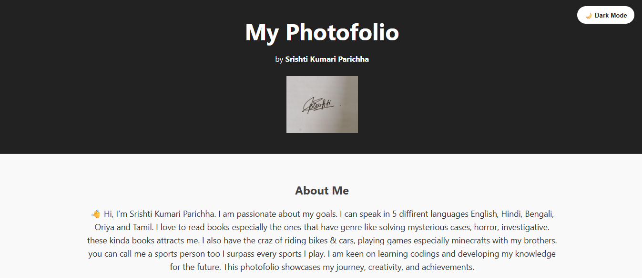

RESULTS AND SCREENSHOTS
3/21/2024 Annual Review
15

Slide 16
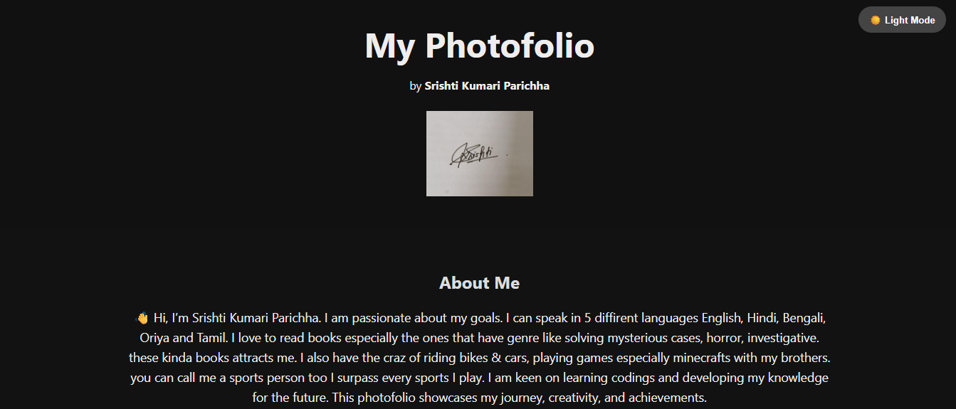

Slide 17
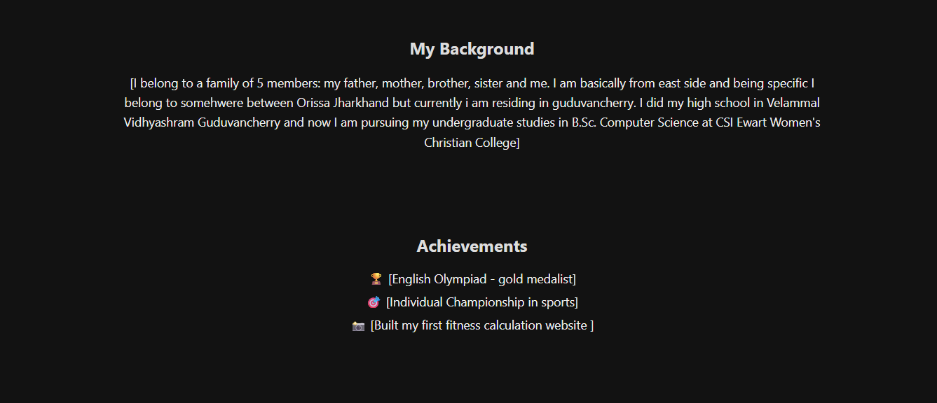

Slide 18
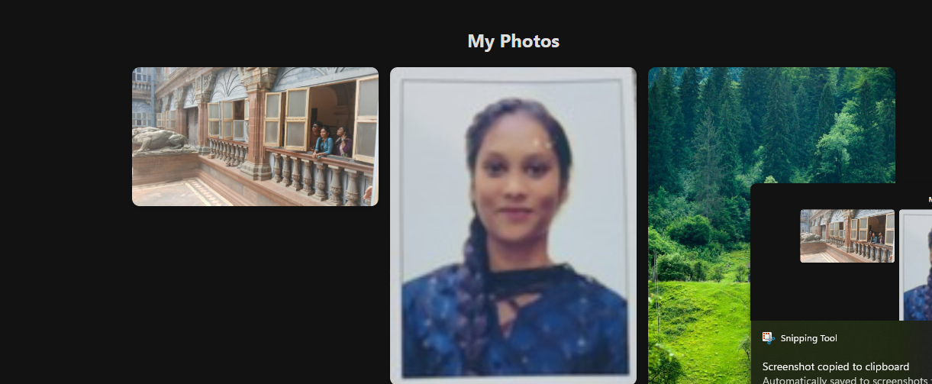

Slide 19
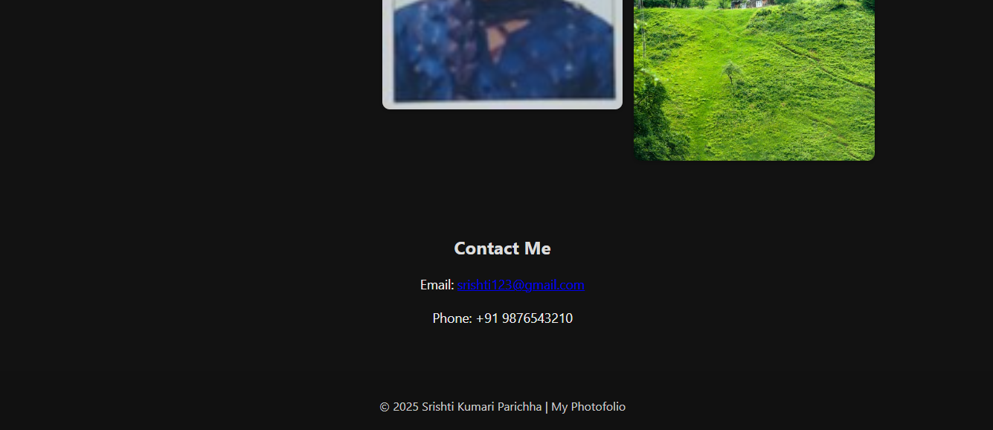

Slide 20
CONCLUSION
ThePortofolio project successfully demonstrates how a personal portfolio can be built using front-end technologies such as HTML, CSS, and JavaScript. The project provides a structured platform to present personal information, background, achievements, and contact details in a visually appealing and organized way. By deploying it through GitHub Pages, the portfolio becomes easily accessible to anyone with the link, creating a professional online presence.
This project highlights the importance of web development skills in creating real-world applications and shows how even simple technologies can be combined to design an impactful digital identity. The Photofolio can further be enhanced with advanced features such as animations, responsive design improvements, and backend integration for dynamic content.
20

